Slide 1
INNING STARS
Mobile App
Search . . .
INNING
"MODERN DAY CRICKET ANALYST"
~YOUR GUIDE FOR FANTASY CRICKET WORLD
STARS
Start Page

Slide 2
PROBLEM STATEMENT:
100
Failure in the Fantasy Cricket World due to lack of knowledge about cricket.
Loss of money in the Fantasy Cricket World.
75
50
25
0
win
loss

Slide 3

OBJECTIVE:
Help to provide economic support to needy people.
Provide equal opportunity to win the game.
Reduce the loss of money due to lack of knowledge of cricket and addiction of Fantasy cricket.

Slide 4
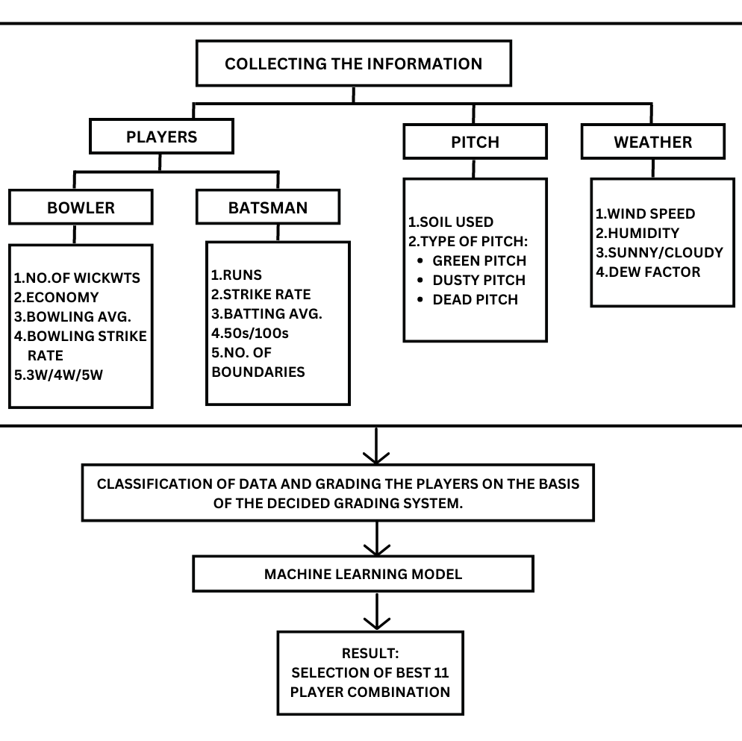
FLOW CHART:

Slide 5
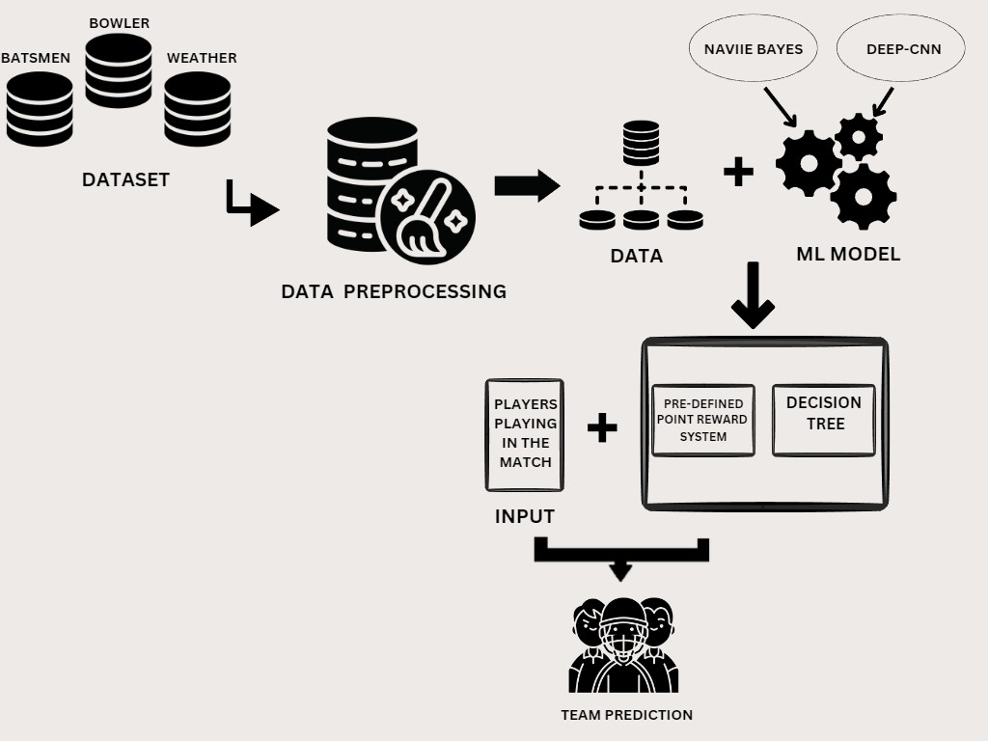
WORK MODEL:

Slide 6
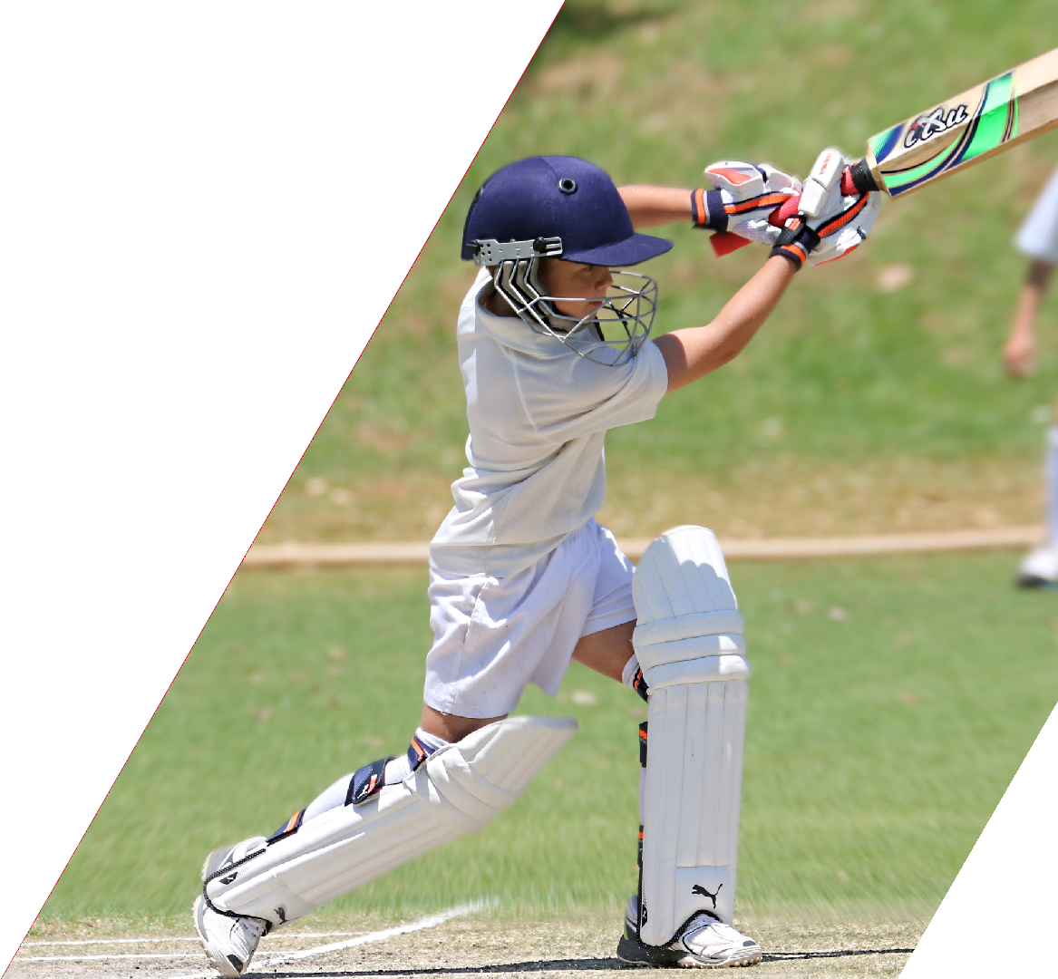
SCOPE:
It can be used by coaches or trainers to improve the player’s performance..
Also, it can be used in preparation of game plan by knowing the strong and weak points of the opposition team players.
Further we can expand to other sports like football, kabaddi,basketball,etc.

Slide 7
THANK YOU
End Of Slide

